Slide 1
IT2402
Free and Open Source Software Solutions
IP Addressing

Slide 2
  1. I Pv4 addressing
  1.1 Address format
  Hierarchical
  Made up of
    Network parts.
    Host parts.

Slide 3
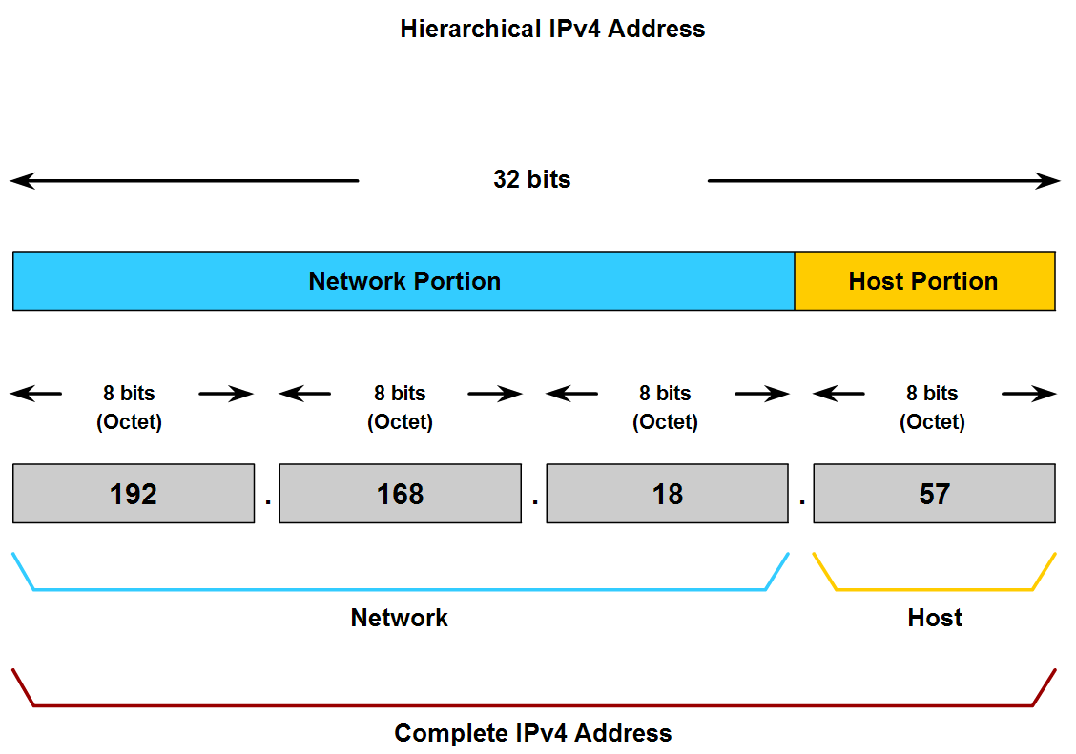
192.168.18.0/24

Slide 4
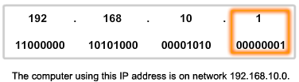
  Host portion
192.168.10.0/24

Slide 5
Network Prefixes
How many bits represent the network portion and how many bits represent the host portion.?

Slide 6
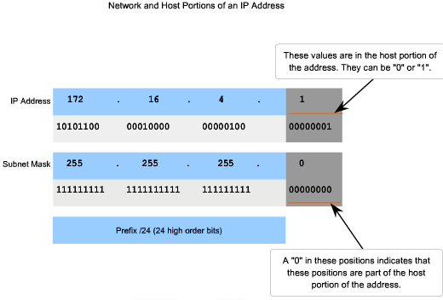

Slide 7
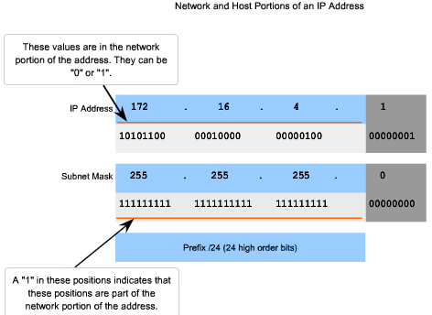

Slide 8
Network Address
172.16.4.10 /24
.
.
.
10
172
16
4
.
.
.
10101010
00010000
00001000
00001010
Network address in binary
.
.
.
00000000
10101010
00010000
00001000
Network address in decimal
.
.
.
172
16
4
0

Slide 9
Broadcast Address
That allows communication to all the hosts in that network.
Uses the highest address in the network range.
The bits in the host portion are all 1s.

Slide 10
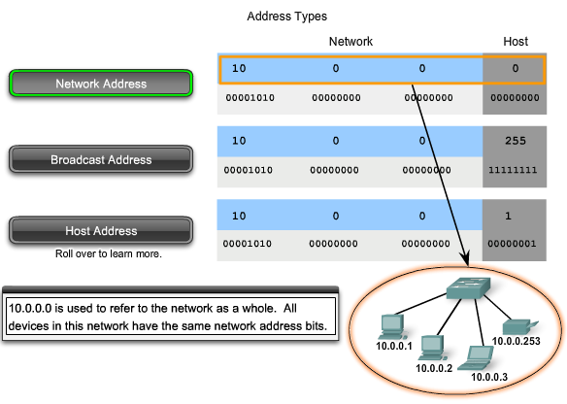
10.0.0.0/24

Slide 11
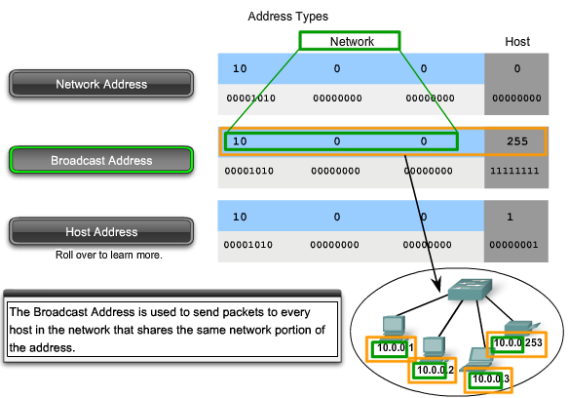
10.0.0.0/24

Slide 12
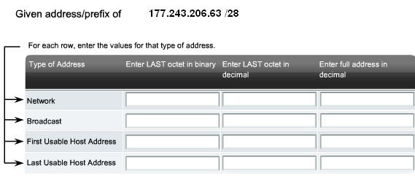
Test yourself – Ex 01

Slide 13
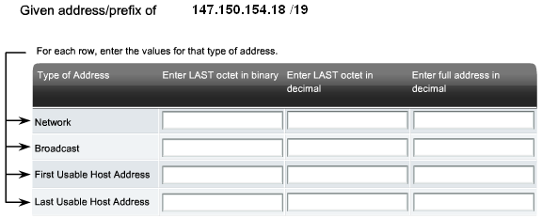
Test yourself – Ex 02

Slide 14
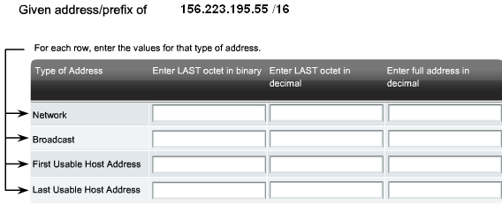
Test yourself – Ex 04

Slide 15
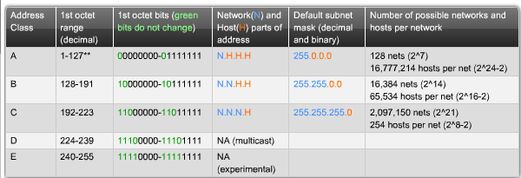
IP Address Class

Slide 16
Private Addresses
The private address blocks are:
10.0.0.0 to 10.255.255.255 (10.0.0.0 /8)
172.16.0.0 to 172.31.255.255 (172.16.0.0 /12)
192.168.0.0 to 192.168.255.255 (192.168.0.0 /16)

Slide 17
Class A Blocks
Class A IPv4 addresses used a fixed /8 prefix with the first octet to indicate the network address. The remaining three octets were used for host addresses.

Slide 18
Class B Blocks
A class B IP address used the two high-order octets to indicate the network address. The other two octets specified host addresses.
For class B addresses, the most significant two bits of the high-order octet were 10. This restricted the address block for class B to 128.0.0.0 /16 to 191.255.0.0 /16.

Slide 19
Class C Blocks
Class C address blocks used a /24 prefix. This meant that a class C network used only the last octet as host addresses with the three high-order octets used to indicate the network address.
For class B addresses, the most significant two bits of the high-order octet were 110.

Slide 20
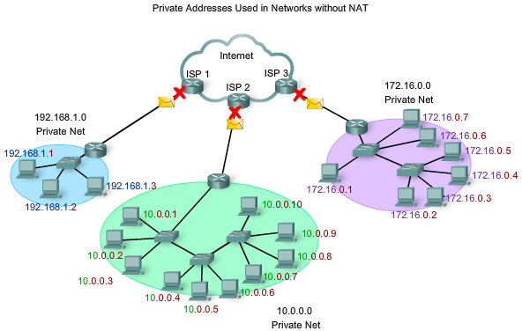

Slide 21
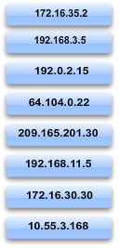
Test yourself – Identify the private and public Ip address given below.

Slide 22
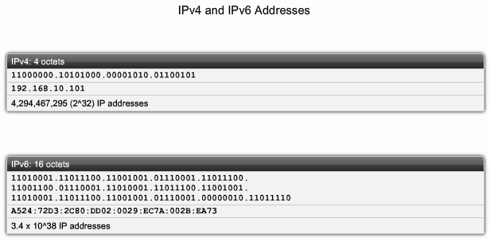
IPv6 Addresses

Slide 23
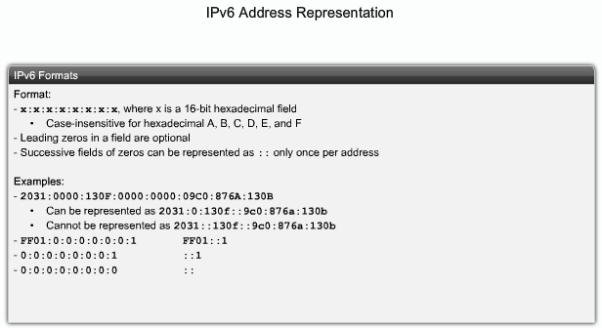
IPv6 Addresses

Slide 24
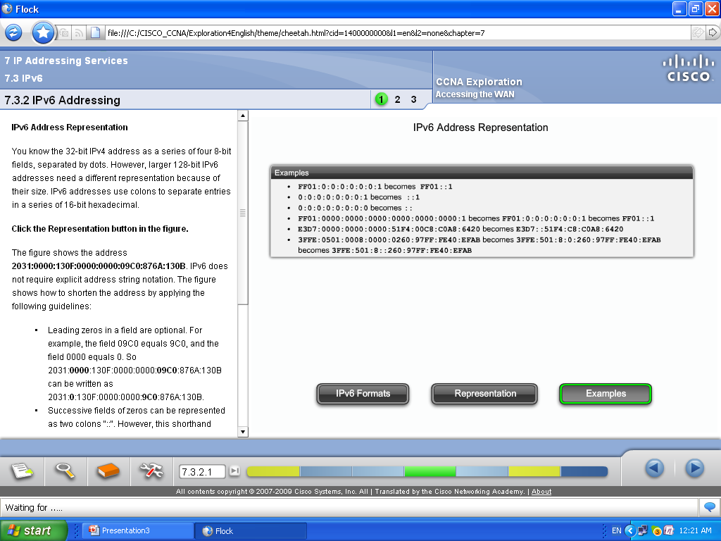
IPv6 Addresses

Slide 25
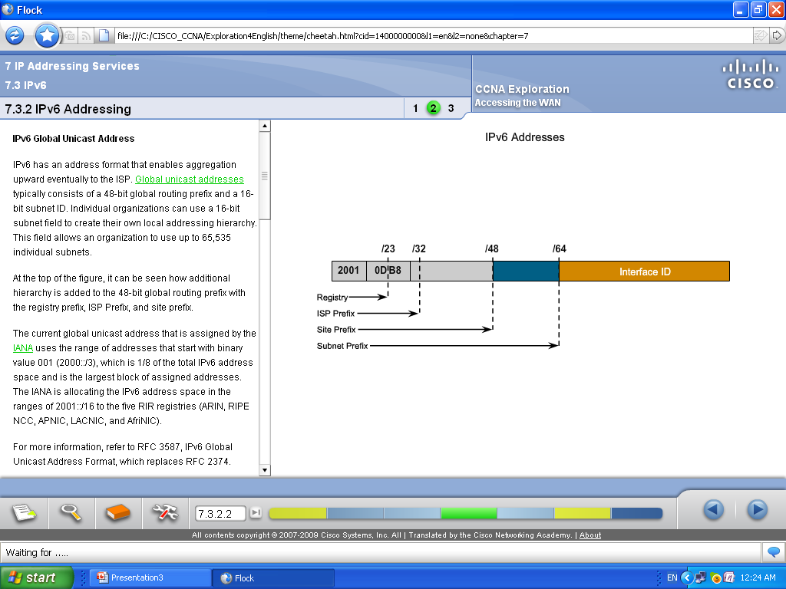
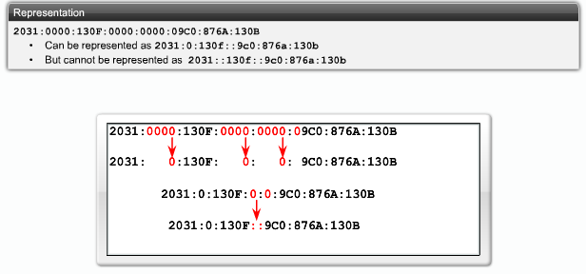
IPv6 Addresses

Slide 26
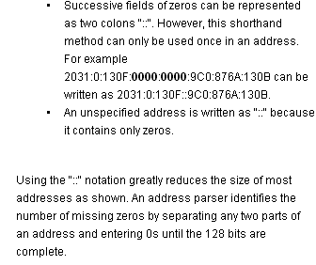
IPv6 Addresses

Slide 27
IPv6 Addresses

Slide 28
IPv6 Addresses

Slide 30
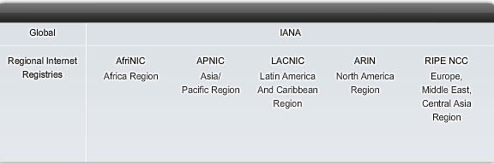
IPv6 Addresses

Slide 31
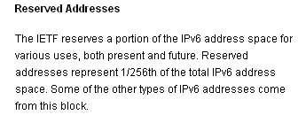
IPv6 Addresses

Slide 32
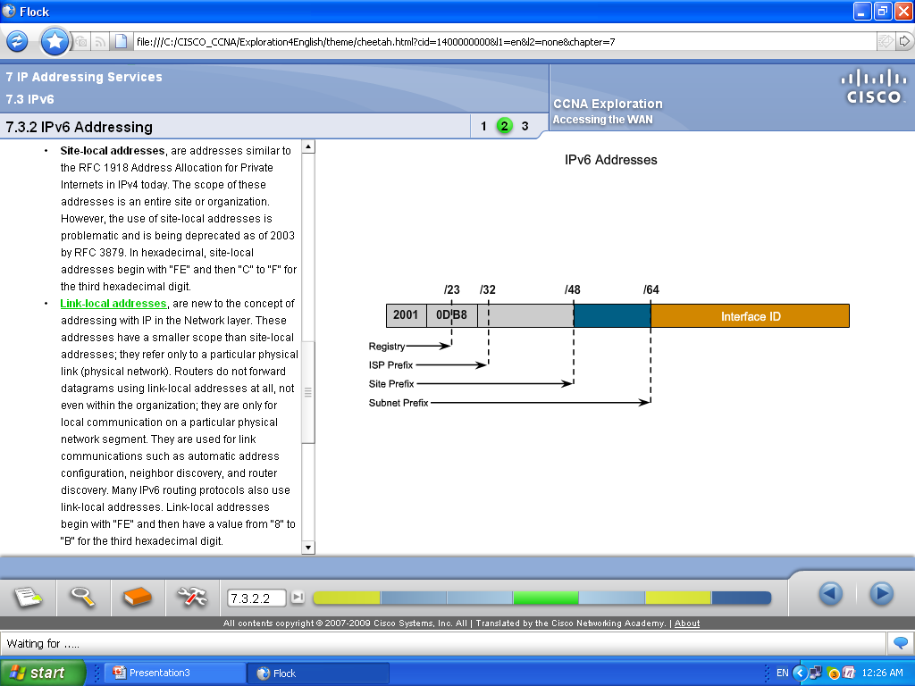
IPv6 Addresses

Slide 33
IPv6 Addresses

Slide 34
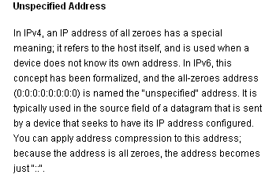
IPv6 Addresses

Slide 35
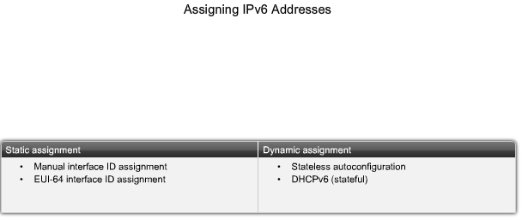
IPv6 Addresses

Slide 36
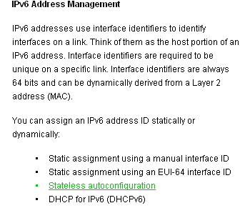
IPv6 Addresses

Slide 37
IPv6 Addresses
Enabling IPV6 in WINXP
C:>nesh int ipv6 install
Disabling IPV6 in WINXP
C:>nesh int ipv6 uninstall

Slide 38
END.

